Slide 1
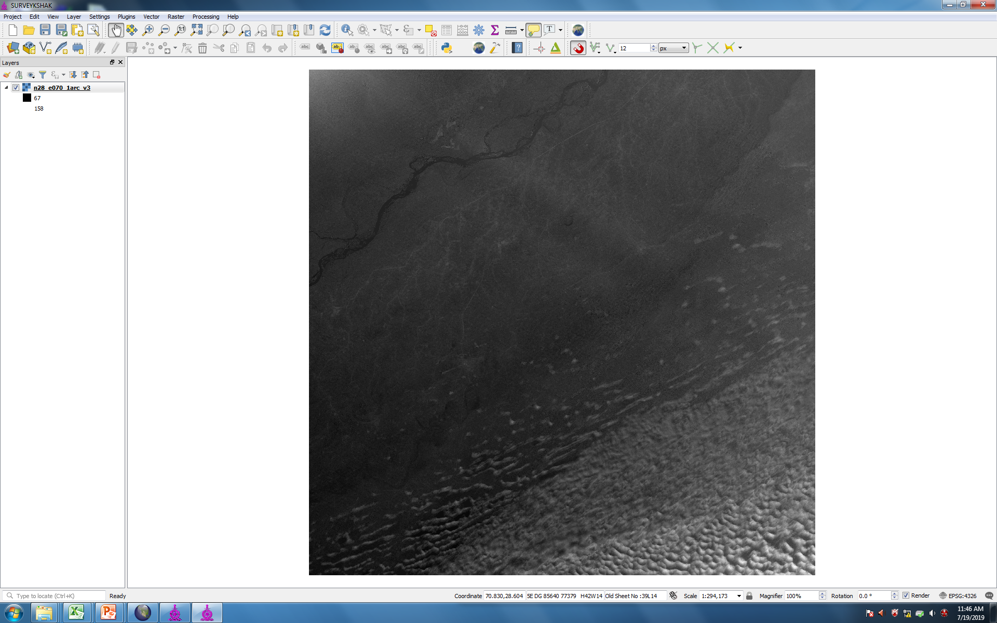
OPEN THE DEM FILE OF .BIL FORMAT

Slide 2
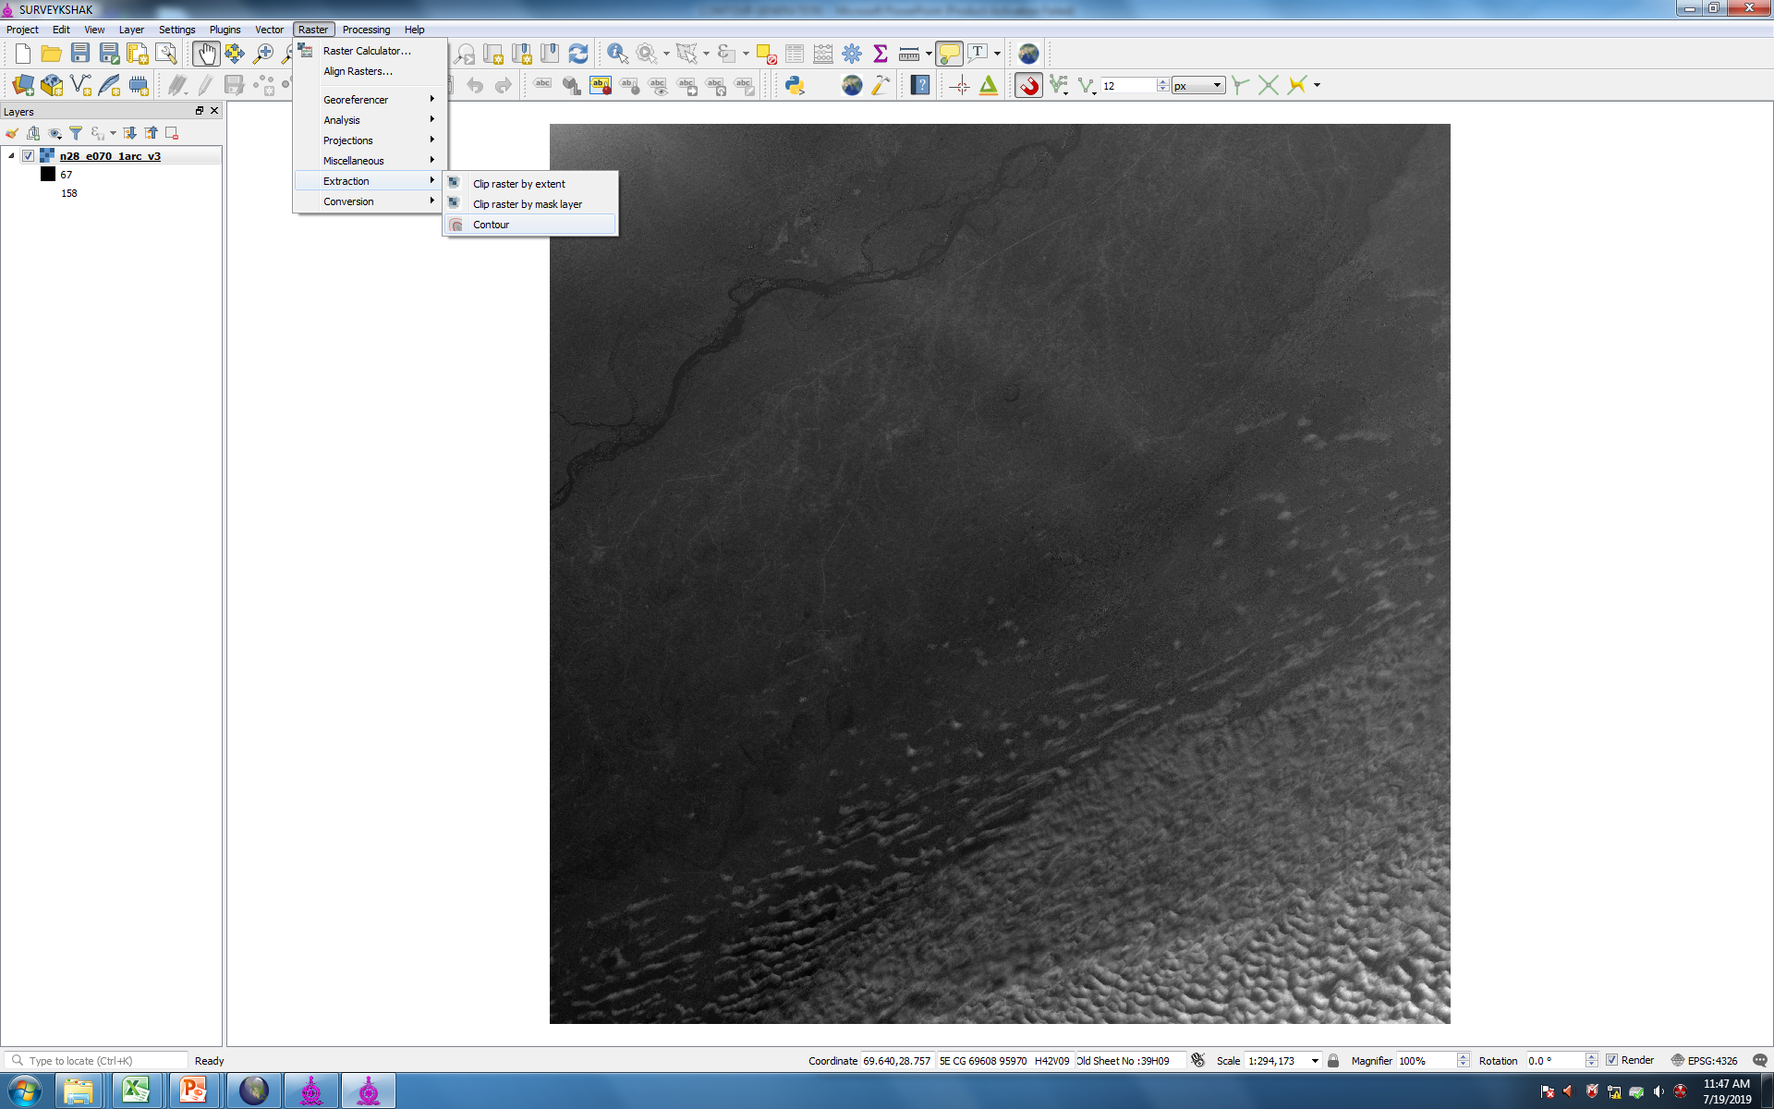
CLICK ON CONTOUR

Slide 3
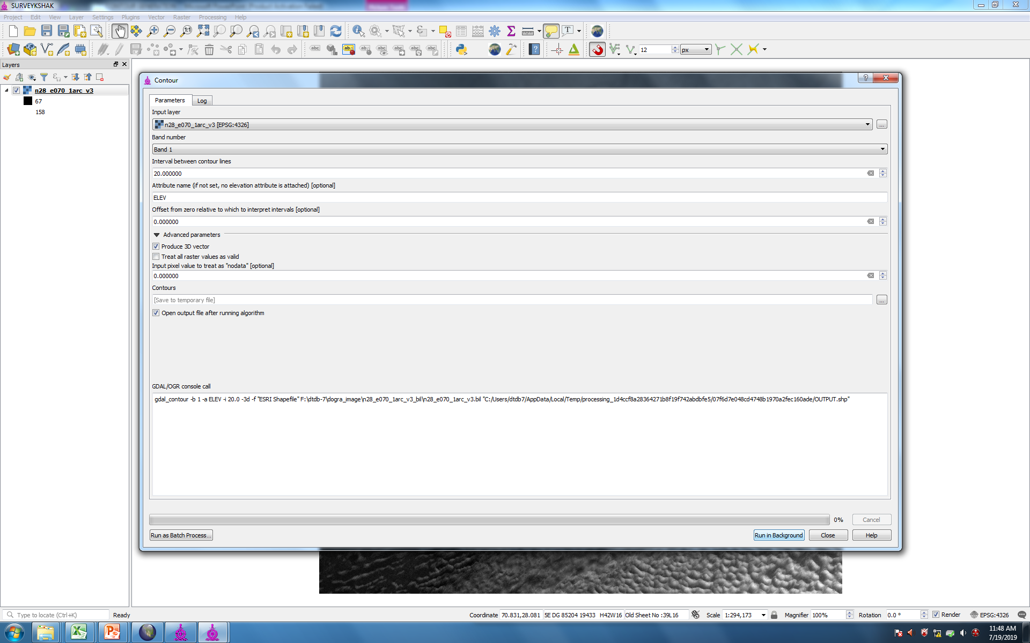

Slide 4
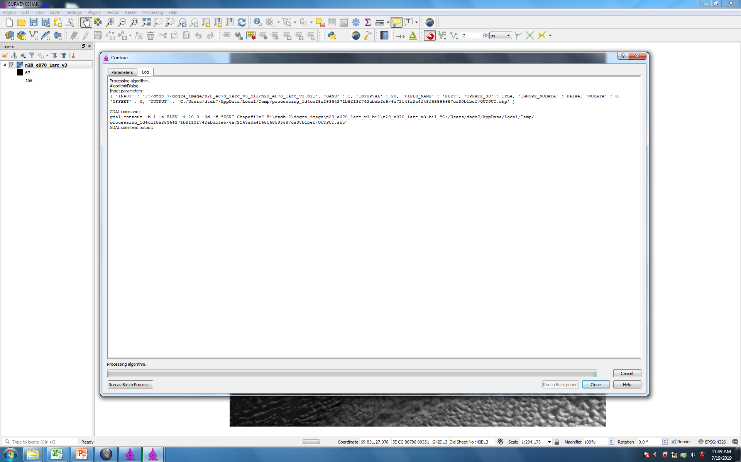
AUTO PROCESS WILL START. IT WILL TAKE 5 TO 10 MIN

Slide 5
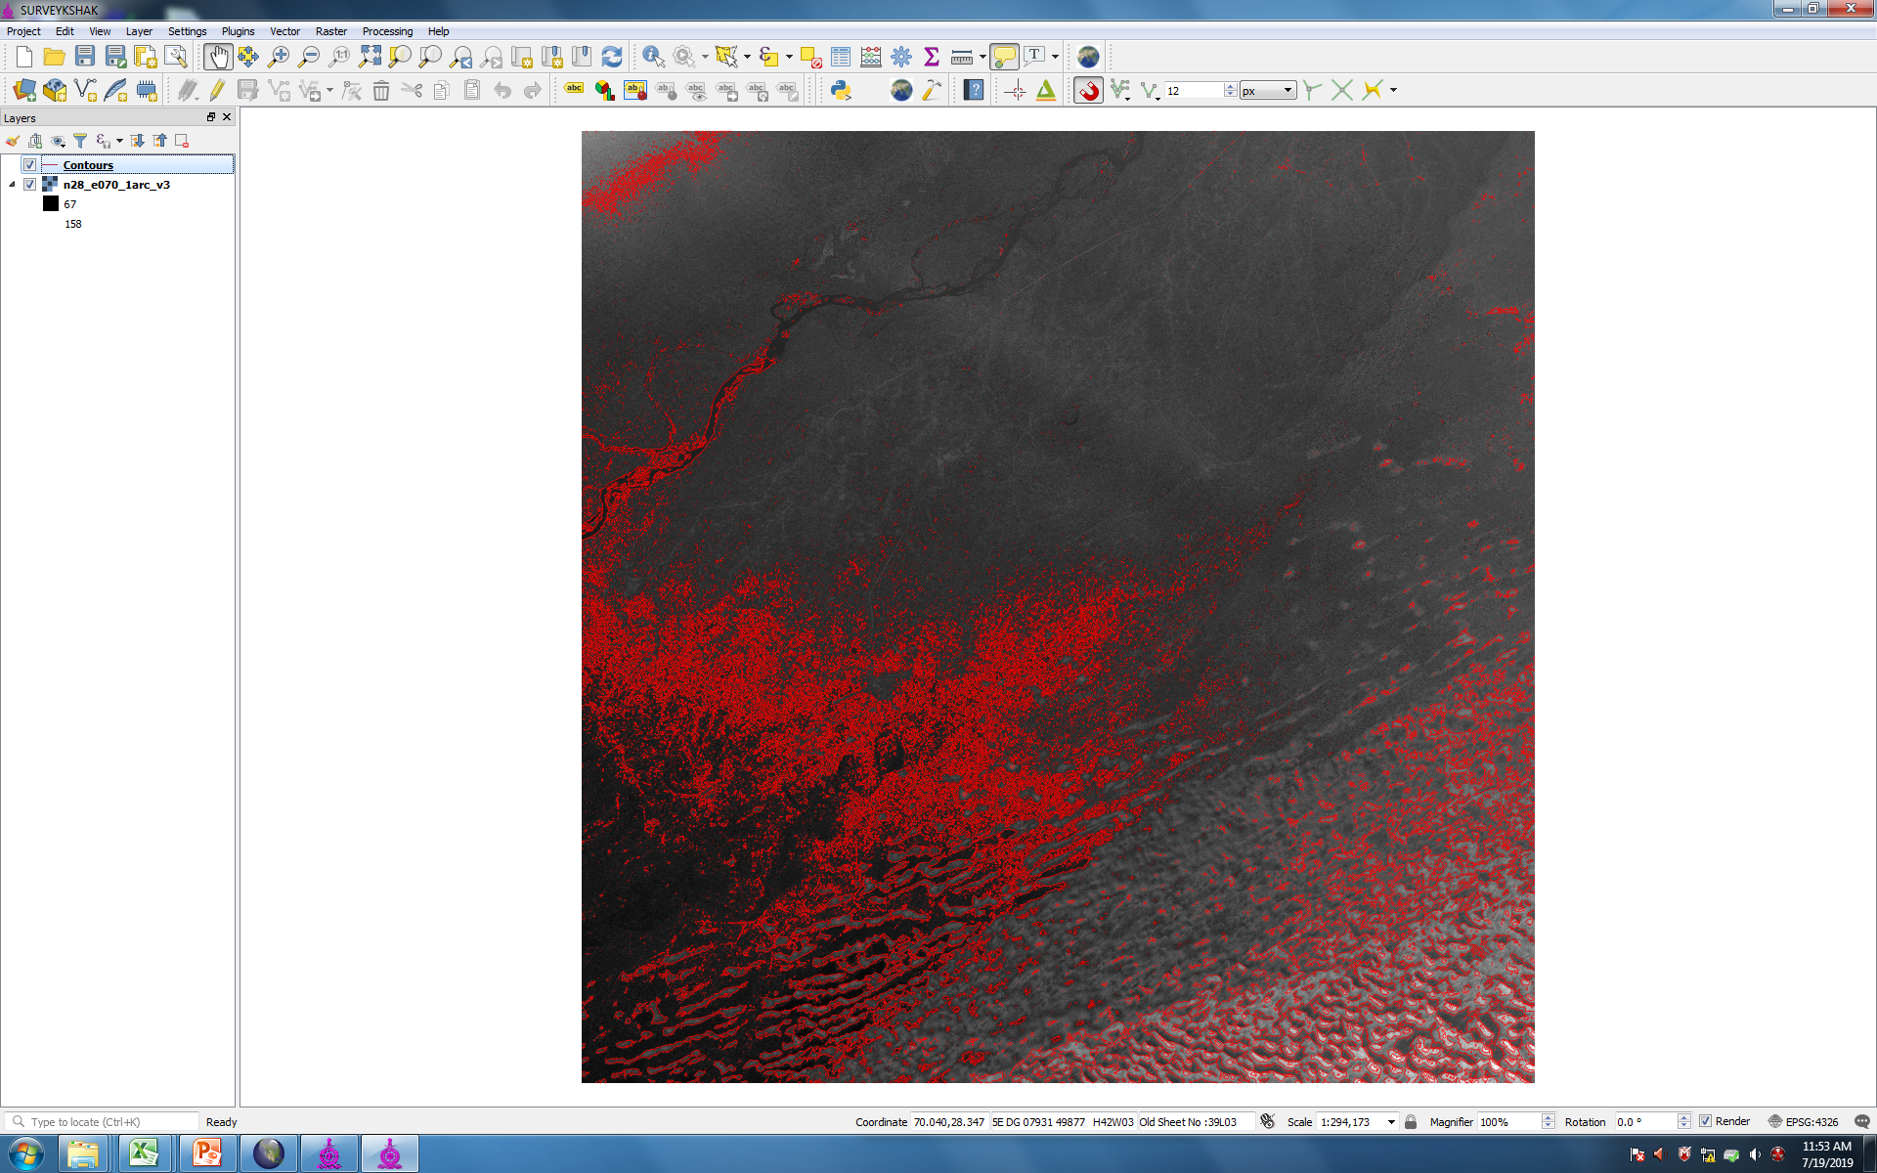
CONTOUR WILL BE GENERATED AS PER REQS

Slide 6
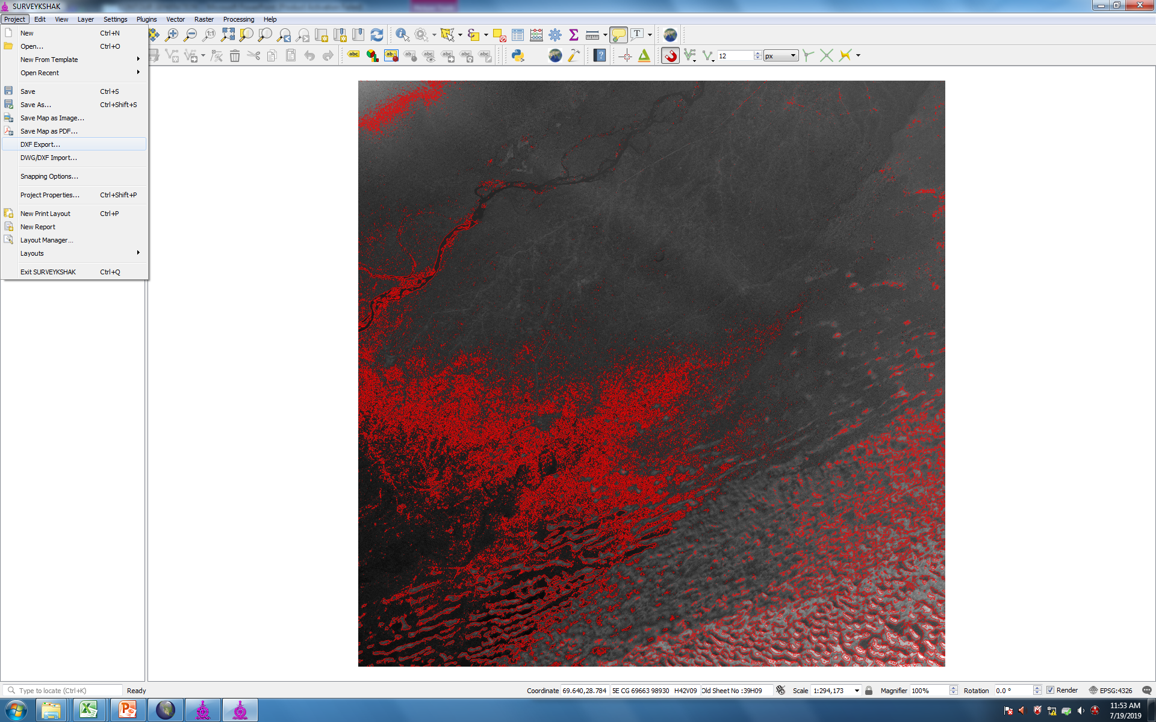

Slide 7
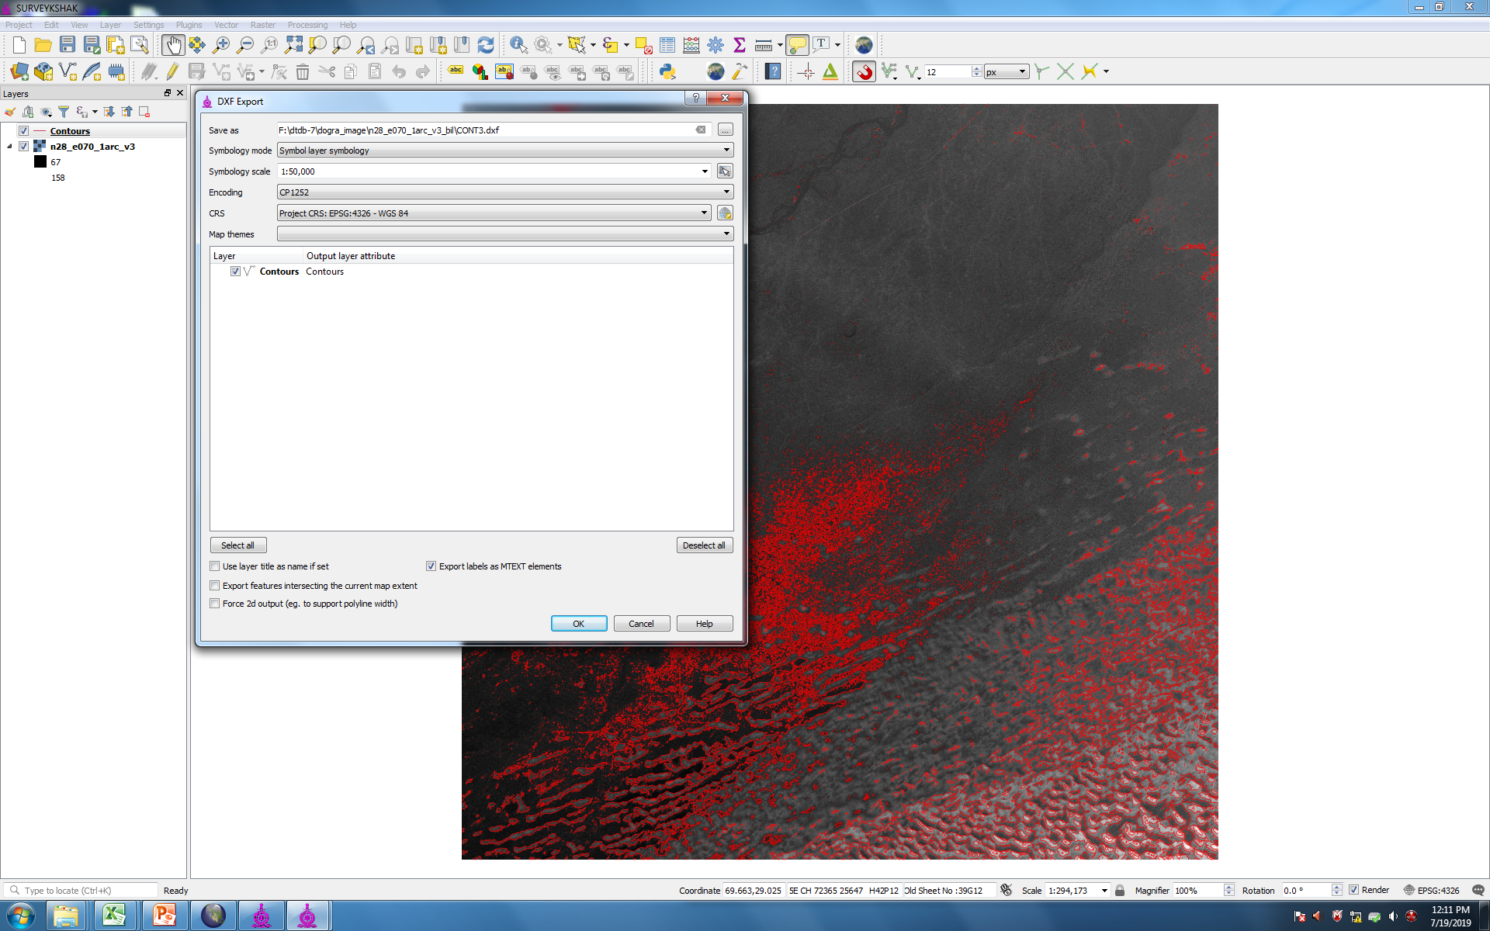
YOU CAN CHOOSE PROJ PARAMETER OF YOUR MAP SHEET

Slide 8
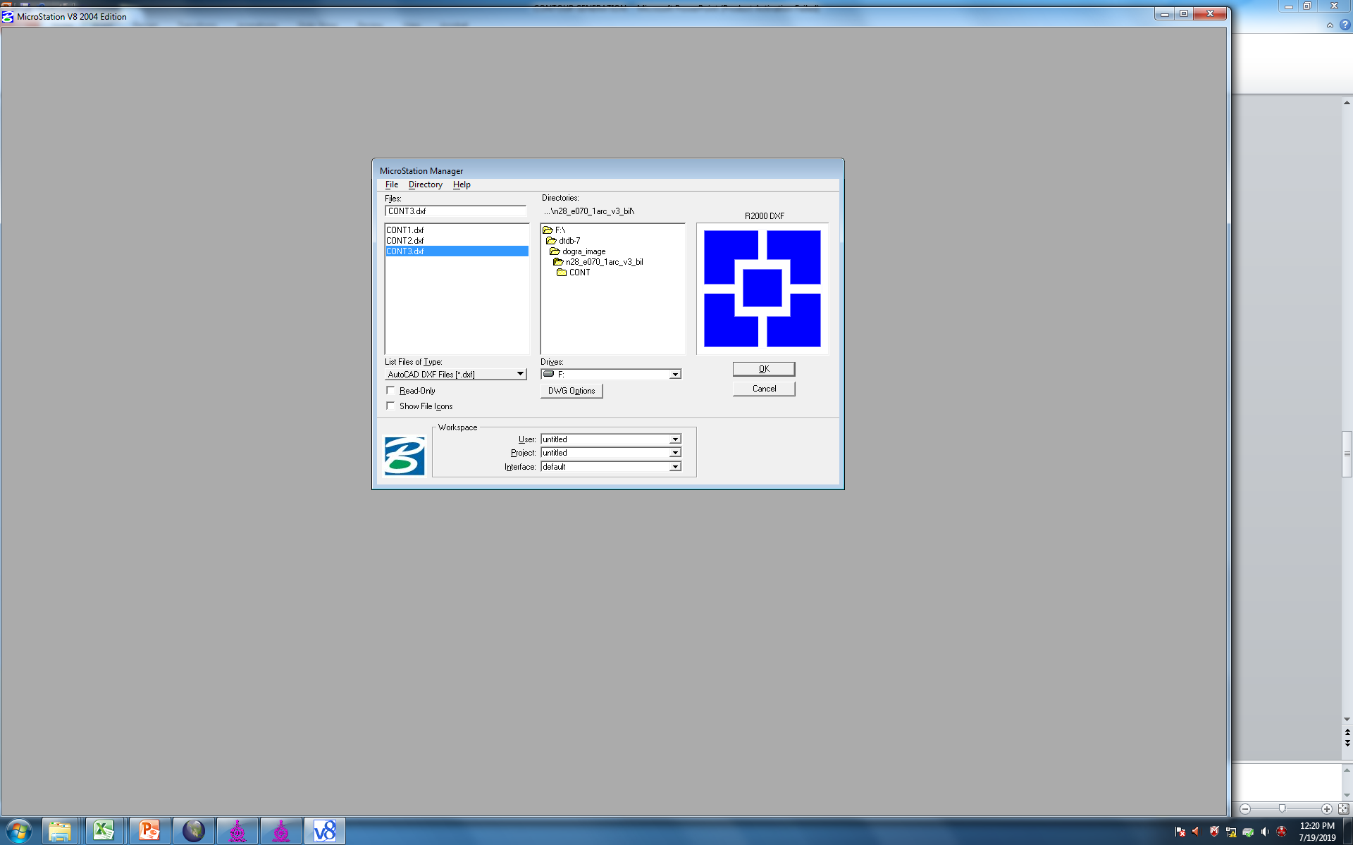
OPEN THE .DXF IN MICROSTATION V8

Slide 9
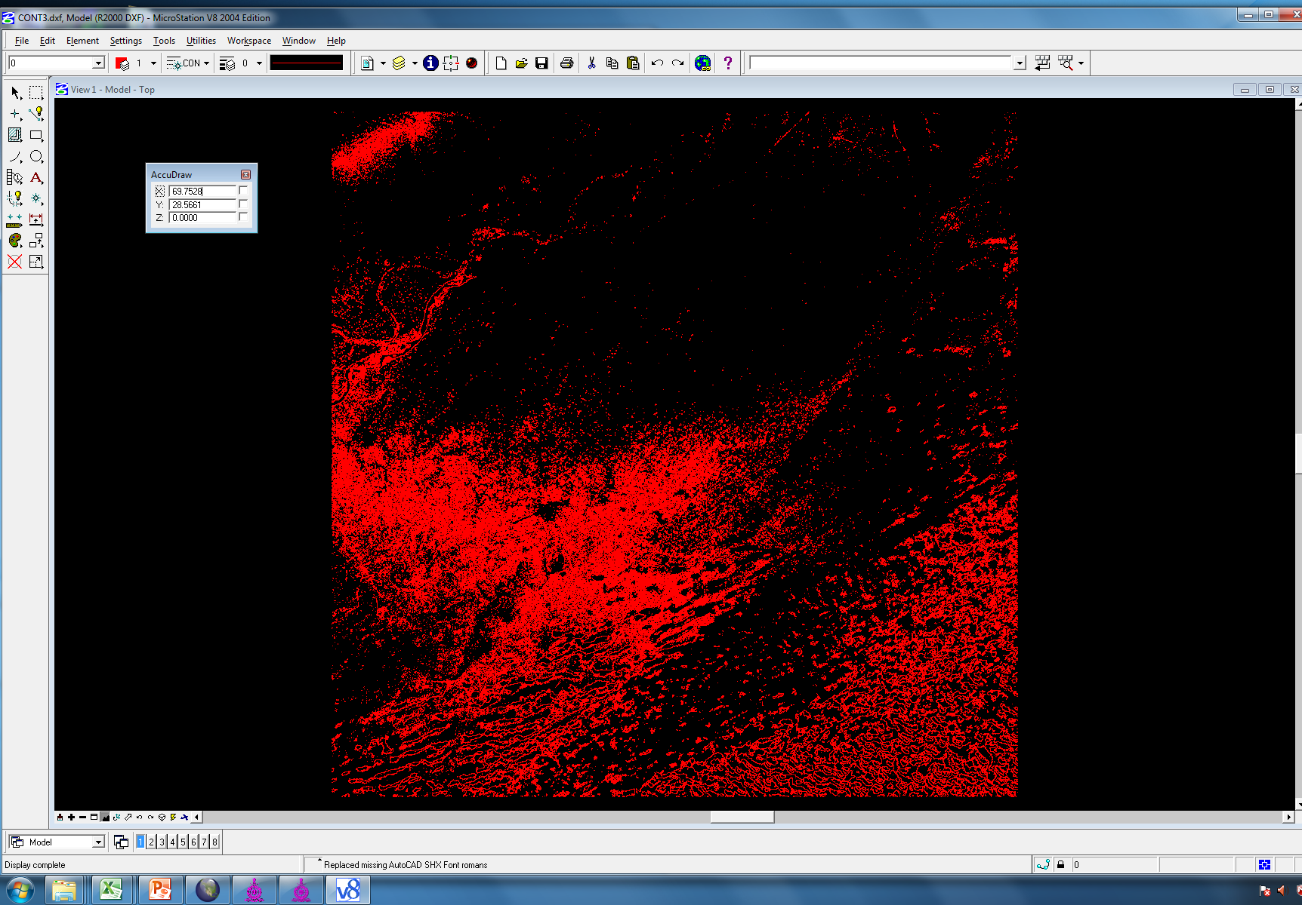
IT WILL OPEN AS 3D FILE

Slide 10
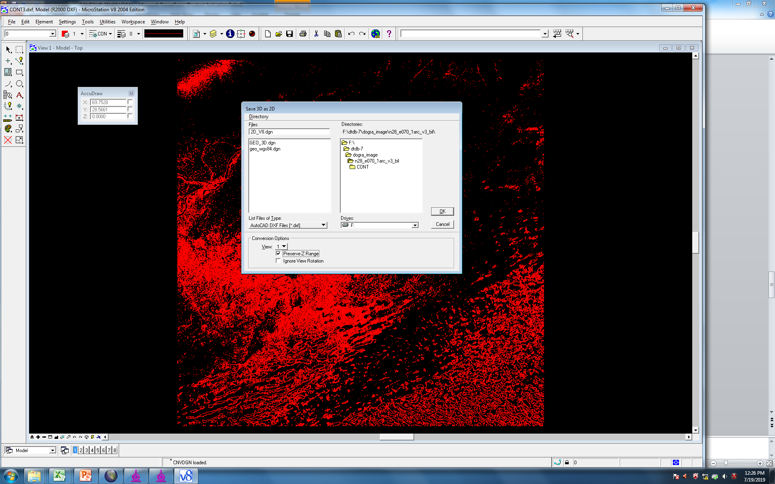
EXPORT IT TO 2D_V8

Slide 11
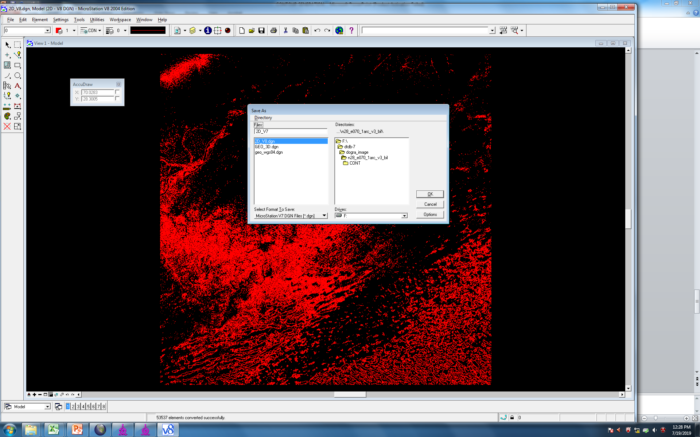
SAVE IT TO 2D_V7

Slide 12
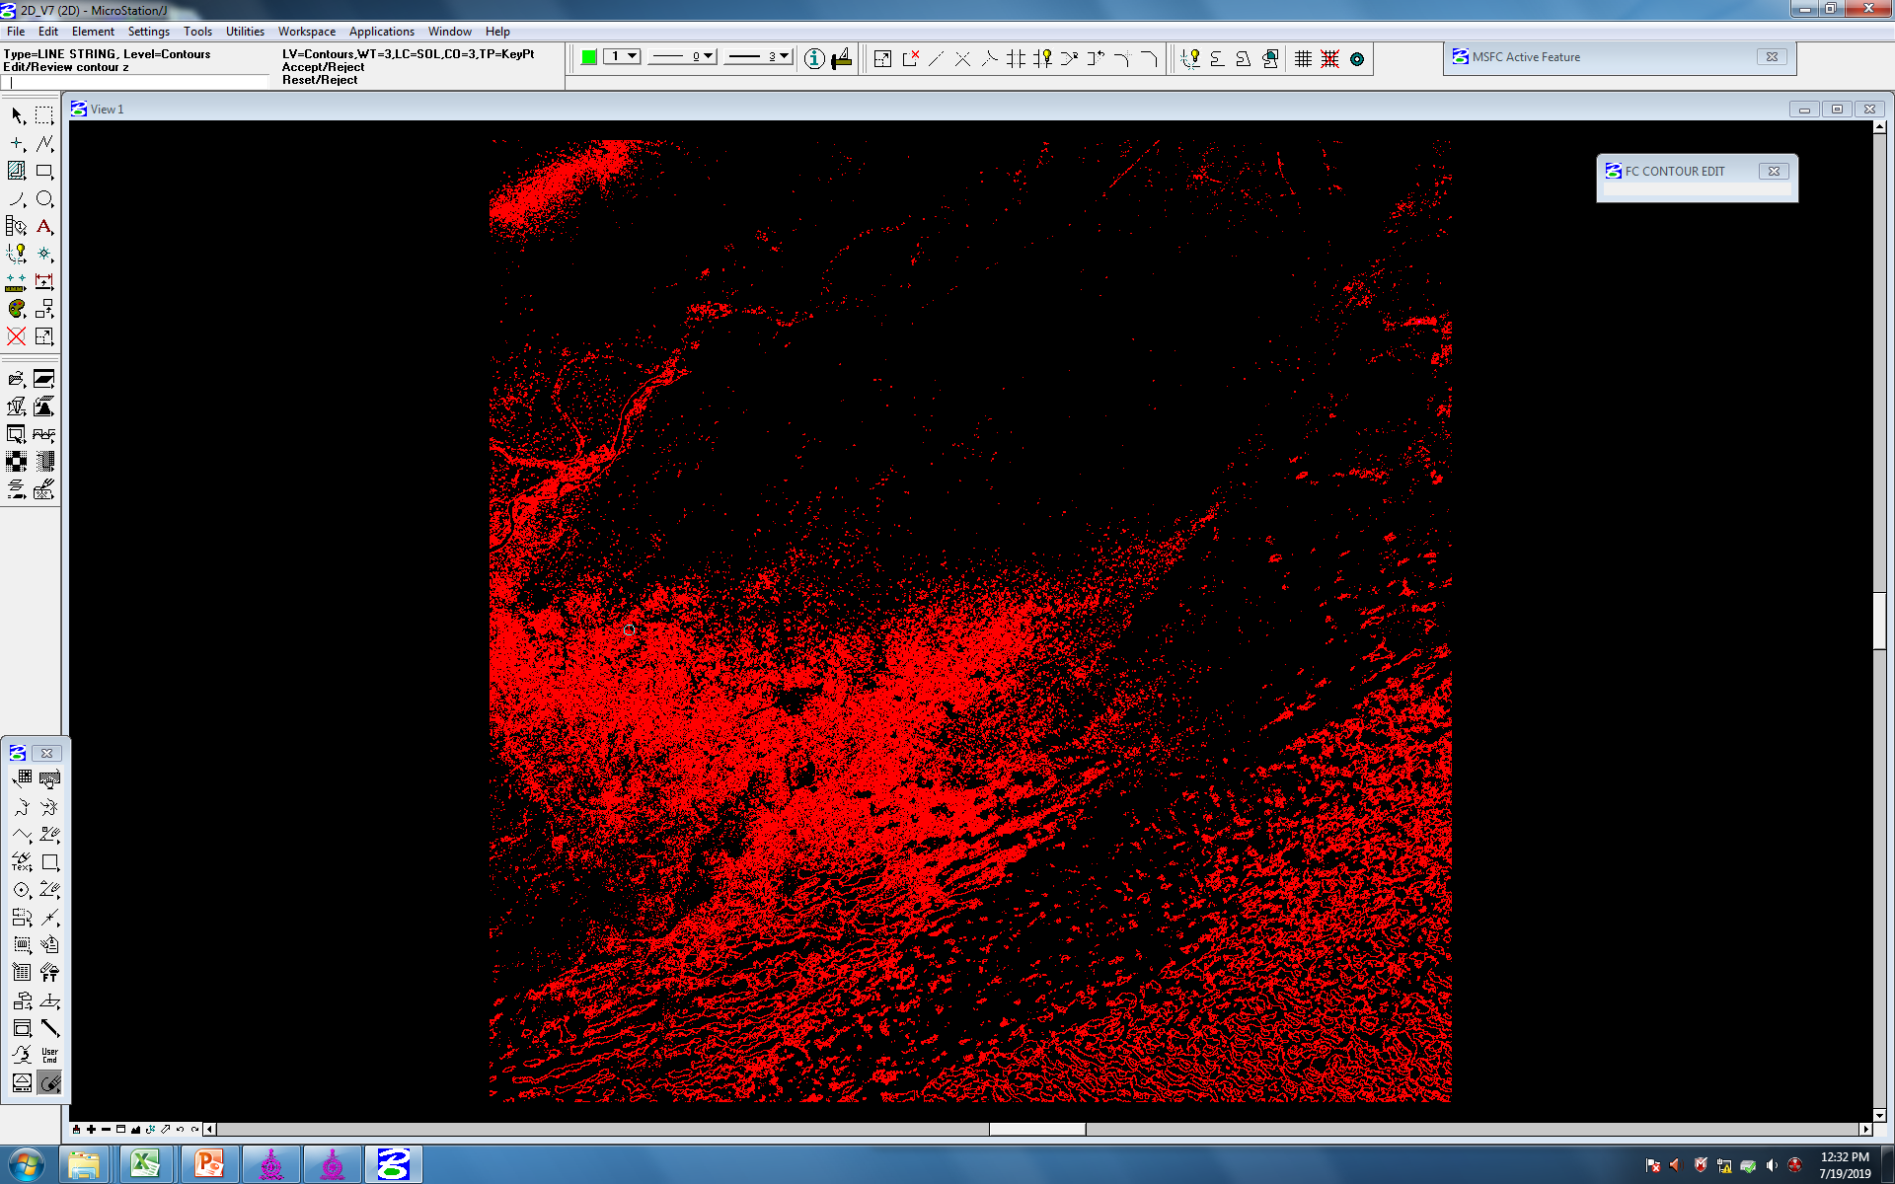
OPEN THE FILE IN V7 AND READY TO USE

Slide 13
